Slide 1

Used Cars Price Prediction Models
Team 2:
Rodrigo Figueroa
Carlos Valencia
Pablo Morales
Daniel Bardán
José Franco

Slide 2
Table of contents
01
02
03
04
Project Introduction
Dataset Description
Used Car Price Prediction
Info on used cars
Data Preprocessing
Dataset Splitting
You can describe the topic of the section here
Train-Test

Slide 3
Table of contents
05
06
07
08
Model Evaluation
Model Selection and Training
Metrics & Model Results
Result Analysis
Conclusions and next steps

Slide 4
—Henry Ford
"There is no failure except failure to serve one's purpose."

Slide 5

01
Project Introduction
Used Car Price Prediction

Slide 6

Project introduction
Develop a machine learning model to predict the price on used cars based on their features.

Slide 7
Corporate strategies
Mission
Objectives
Vision
Clear the market of speculations
Assist buyers and sellers in determining the fair market value of vehicles.
A tool that will use for everyone

Slide 8
Decisions:
Desirability
Your car
Profitability
Feasibility
The market
The projection
The model
Notes:
Hasta esta slide terminara mi dialogo - Rodrigo Figueroa

Slide 9

Demo software & app
You can replace the image on the screen with your own work. Just right-click on it and select “Replace image”

Slide 10

02
Dataset Description

Slide 11
Data used
Price
Year
Make and Model
The target value to predict
Year of manufacture
Identifiers of the car’s brand and model
Mileage
Conditions
Number of miles the car has traveled
Overall conditions of the vehicle

Slide 12

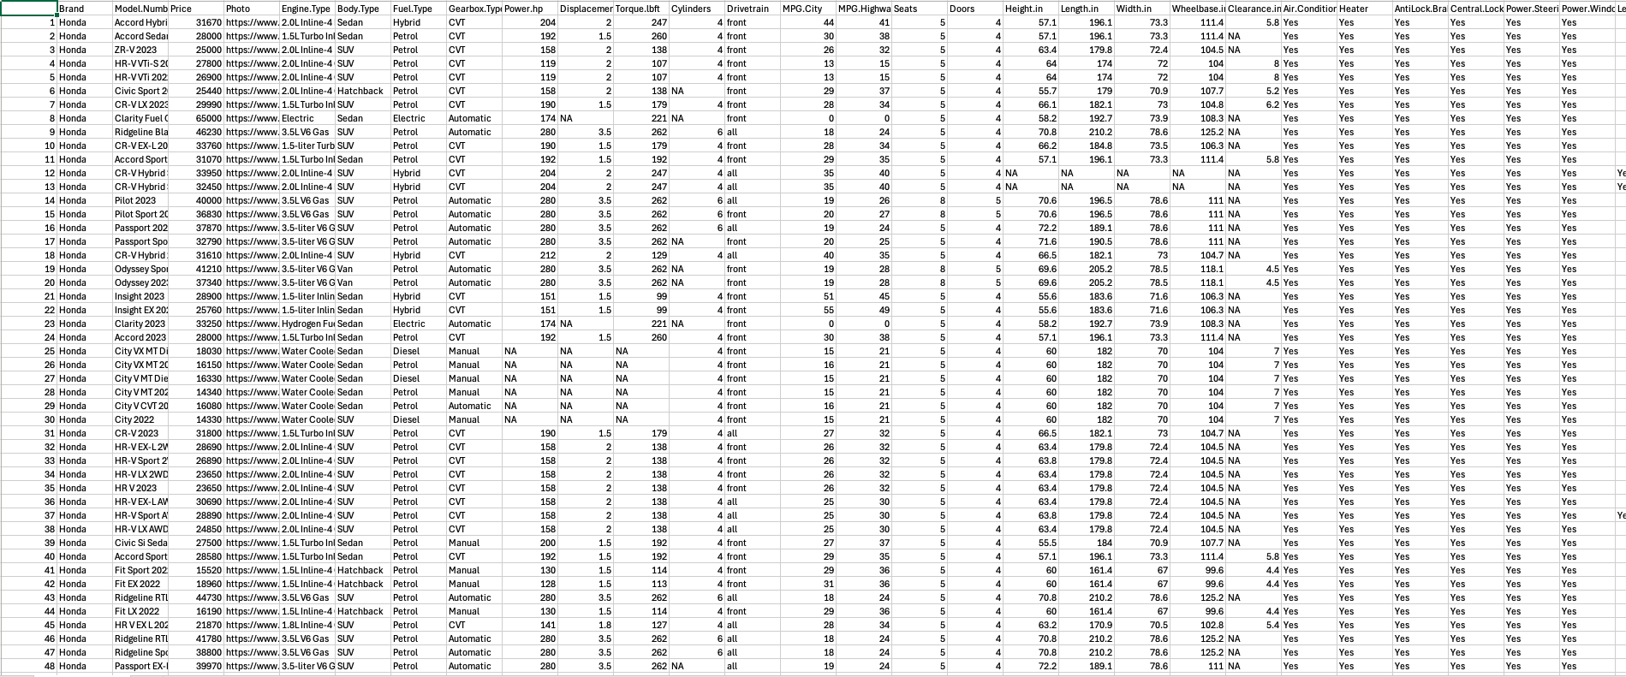
Extract from Data Used

Slide 13

03
Data Preprocessing

Slide 14

Data Preprocessing
Handling Missing Data
Categorical Variable Transformation
Scaling Numerical Data
Clean Data Visualization

Slide 15

04
Dataset Splitting

Slide 16
Train-test Split
80%
20%
Training Set
Test Set
Of the data
Of the data
Purpose: Validate the model’s ability to generalize to unseen data

Slide 17
05
Model Selection and Training

Slide 18
Model Selection and Training
Linear Regression
Random Forest
Simple starting point for modeling
Robust ensemble model for handling non.linear relationships
Support Vector Machines
Hyperparameter Op
Performance comparison for cross-validation
GridSearch CV for best parameters

Slide 19
06
Model Evaluation

Slide 20
Metrics used and Model Results
Mean Square
Best Model
RandomForest
MS
M
Measure of the average
Random Forest
R2
RMSE
R
L
% of variance
2,000 (example)
Mean Absolute
R2
MS
E
Average of differences
0.89 high accuracy

Slide 21
07
Results Analysis

Slide 22
Feature Importance
Worst peer
Best peer
Year
%
%
%
Mileage
%
Make and Model
%
%
Company 1
Company 2
Company 3

Slide 23
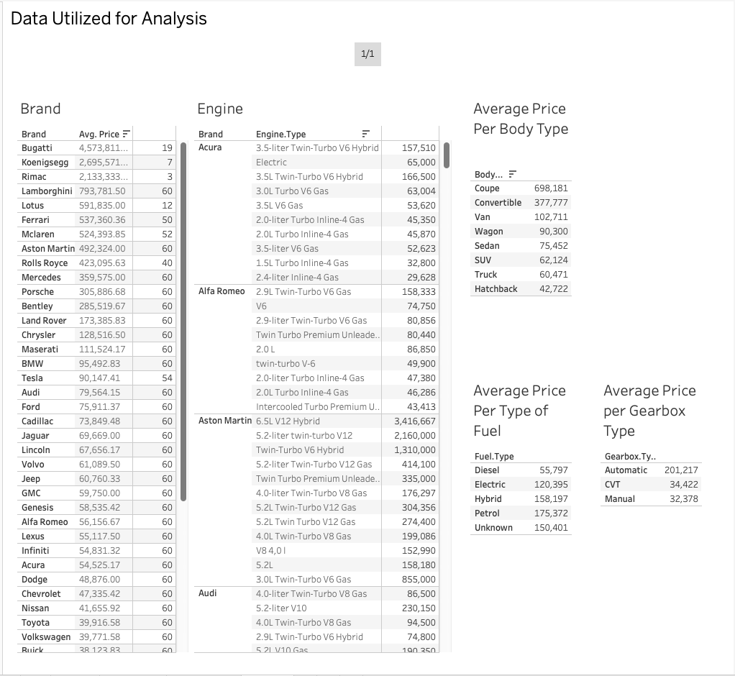
Feature Importance Visualization
A complete visualization of the Tableau project can be found here

Slide 24
08
Conclusions and Next Steps

Slide 25
Conclusions and Next Steps
Key features impacting prices were clearly identified
Include additional data like geography
Random Forest
Market
Geography
Prices
The Impact of supply and demand
Highly effective in predicting used car prices

